Slide 1

“A good movie is three good scenes and no bad scenes”
- Howard Hawks
TMDB Movie
Analysis
using
Machine Learning Techniques
By subhadwip Manna
Guided by Dr. Aakansha Gupta

Slide 2



Introduction
In this project, we utilized the TMDB movie dataset to predict movie Ratings , Genre and Revenue. Through our comprehensive machine learning analysis, we successfully identified the key factors that significantly influence the ratings of movies. By exploring various features such as cast, budget, genre, and release date, we gained valuable insights into the determinants of a movie's success. Our findings provide a deeper understanding of the factors that contribute to high-rated films, enabling better decision-making in the film industry.
Here , we used “Jupyter Notebook, Python Language and its certain libraries” to train and build the different machine learning models and “Tableau” to show some visualisation graph and Interactive Dashboards.

Slide 3
-:Steps:-
Data collection
Exploring data
Visualizations
EDA
Understanding relations
Tableau Dashboards
Data exploration
Missing value treatment
Feature engineering and reduction
Splitting data
Feature scaling
Resampling
Data Preprocessing
Regression
Classification
Clustering
Building Model
Linear regression
Decision tree Regression
Random forest Regression
Ada-boost Regression
K-Nearest neighbour Regression
Stacked Regression
Logistic regression
Naïve Bayes' Gaussian classification
Decision tree classification
Random forest classification
Ada-boost classification
K-Nearest neighbour classification
Stacked classification
KMeans
Agglomerative Hierarchical clustering
DBSCAN
Insights for Business

Slide 4
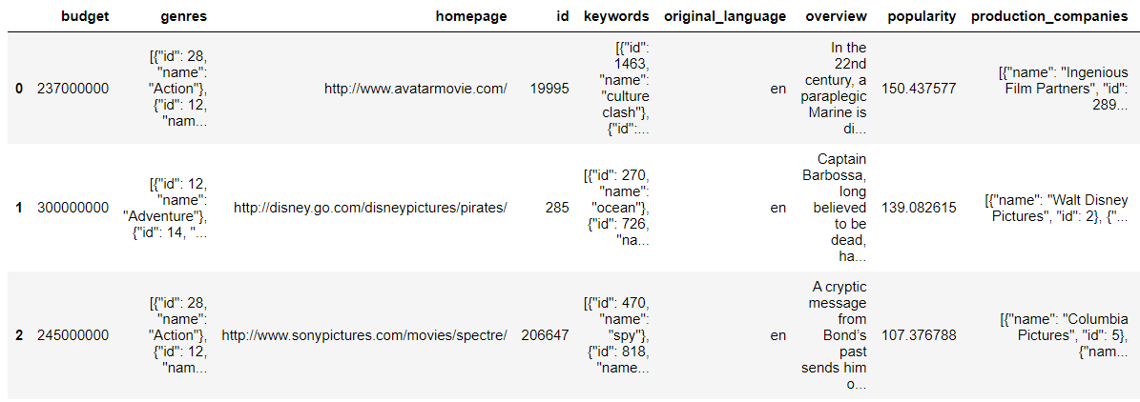
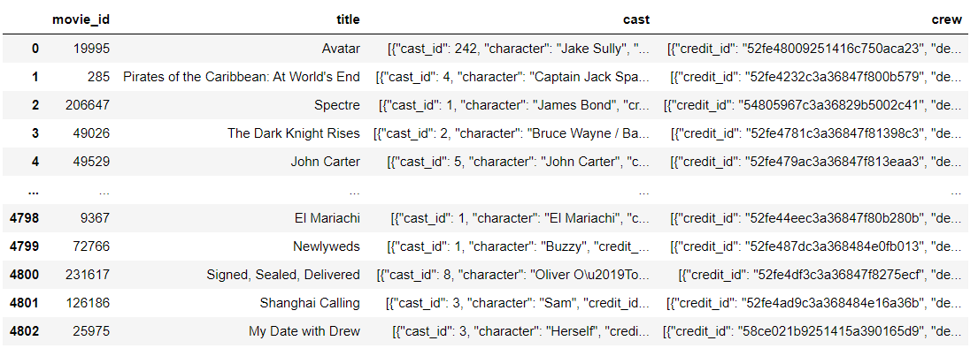

-:Data Overview:-
Movie Data
Number of records :4803
Number of features : 18
Credit Data
Number of records :4803
Number of features : 4

Slide 5
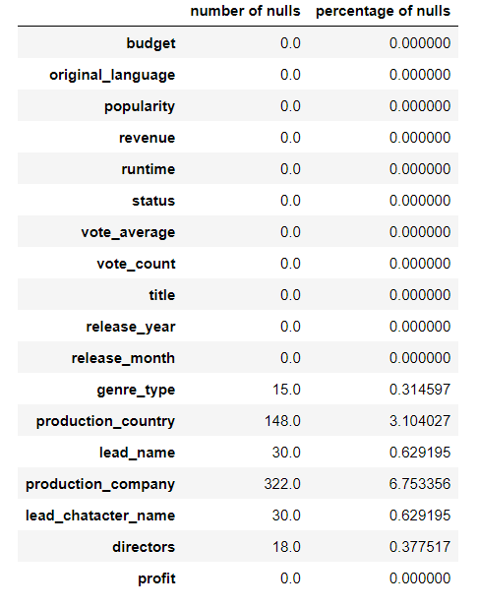
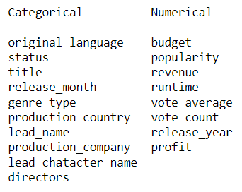
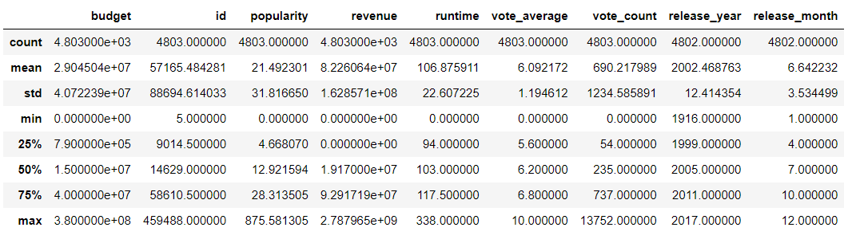
-:Data Cleaning:-
Merging of Dataframes.
Data imputations and cleansing.
Data statistical descriptions.
Data format conversion JSON to string.
New columns created by extracting data from json format such as “genre_type”, “director” etc.
Data imputations and cleansing for new Dataframe.
New feature “profit” created by subtracting “budget” from “revenue”.
Final
Number of records :4419
Number of features : 18

Slide 6
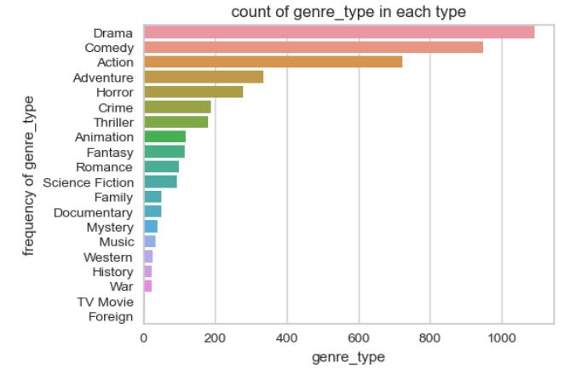
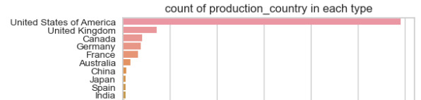
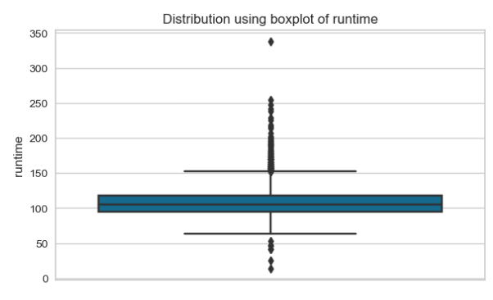
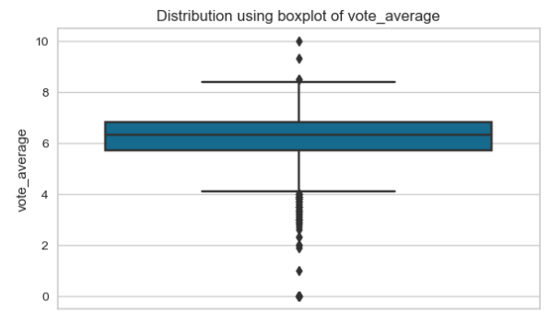
-:Data Exploration:-
Univariate Analysis
Most of the movies are Drama, Comedy and Action type
Almost all the movies are from USA
Most of the movie’s runtime lies between 80 to 130 mins.
Most of the movie vote average lies from 5.7 to 7.

Slide 7
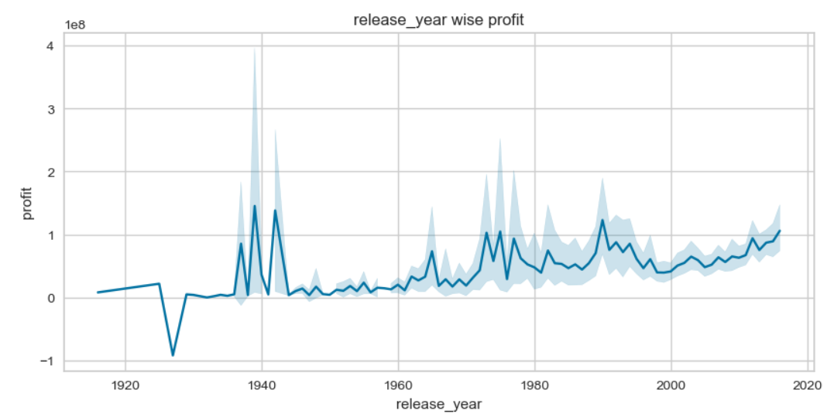
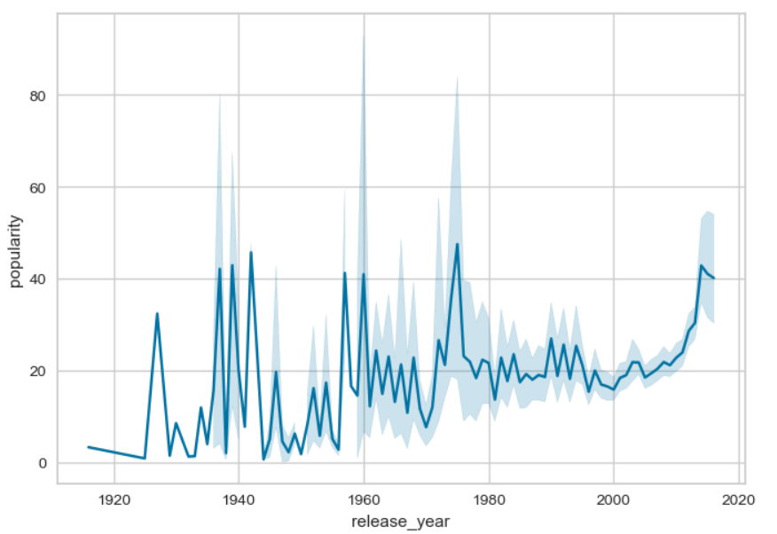
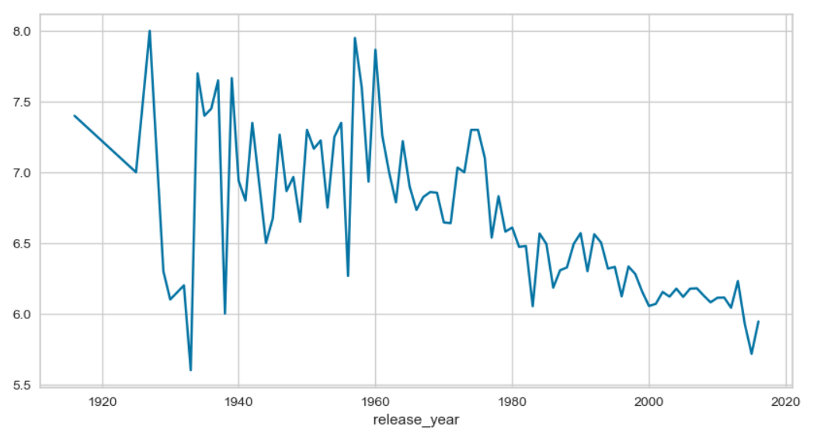
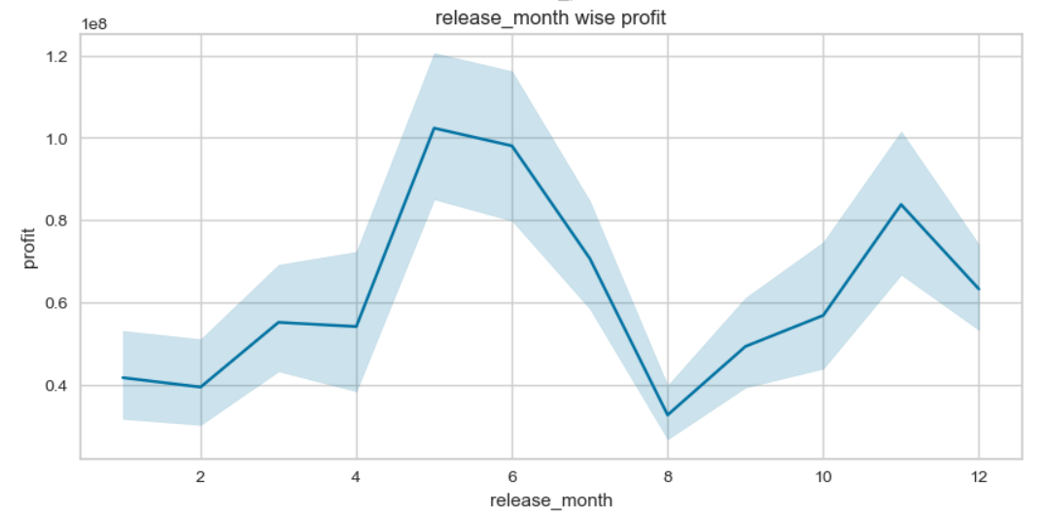
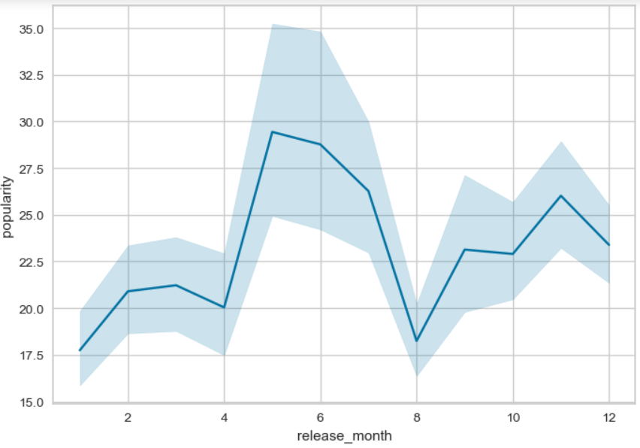
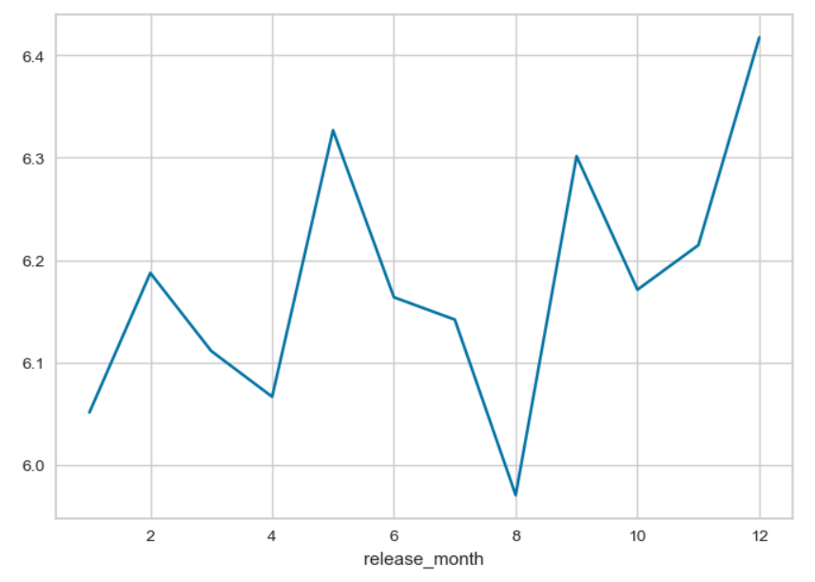
-:Data Exploration:-
Bivariate Analysis
Year wise
Profit
Popularity
Vote_Average
Month wise

Slide 8
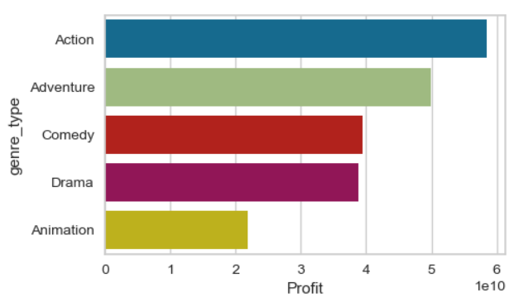
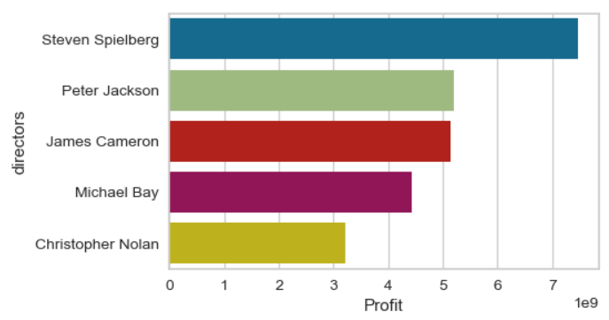
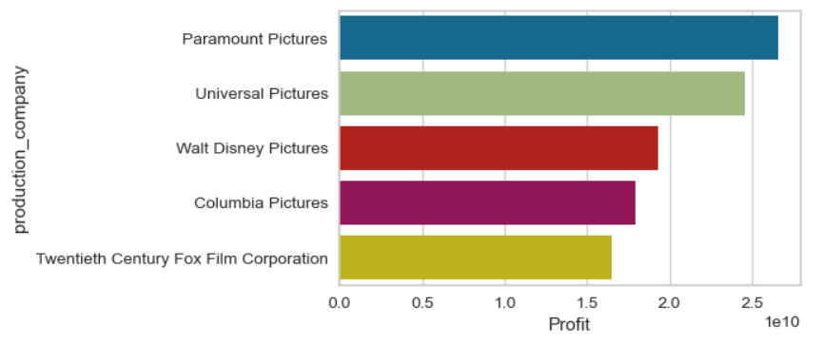
-:Data Exploration:-
Bivariate Analysis
Top categories based on total profit
Directors
Genre Type
Production companies

Slide 9
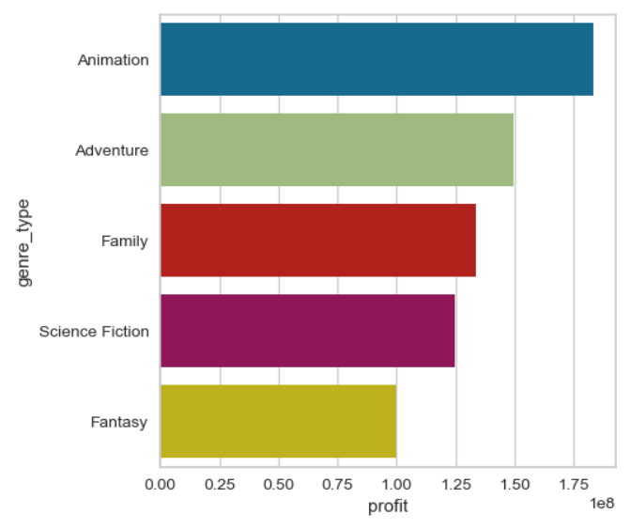
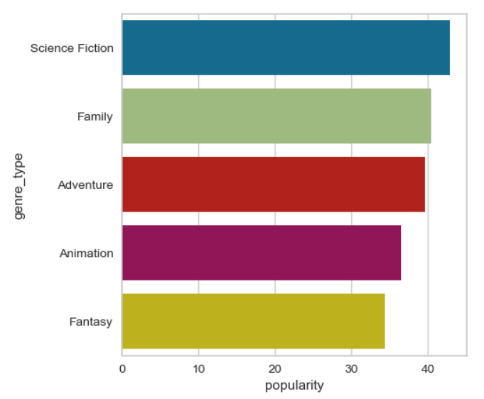
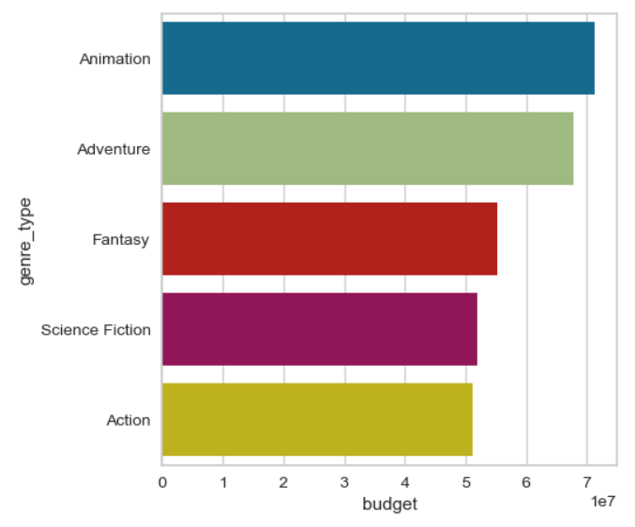
-:Data Exploration:-
Bivariate Analysis
Top genres based on budget , popularity and Profit [Average]
Profit
Popularity
Budget
Animation and Adventure movies have high budget and popularity so there profit is also high.

Slide 10
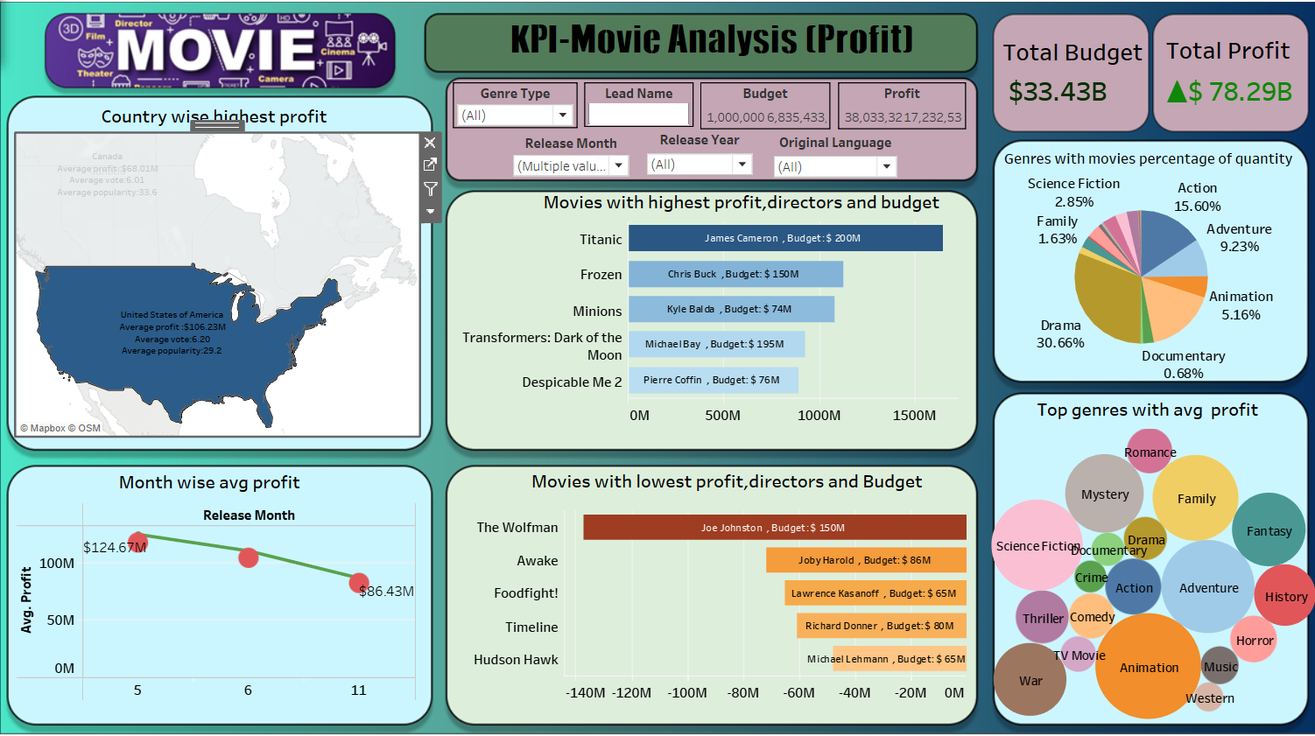
-:Data Exploration:-
Multivariate Analysis
Tableau Dashboard
Top 5 and lowest 5 American movies based on profit which released May, June or November month.

Slide 11
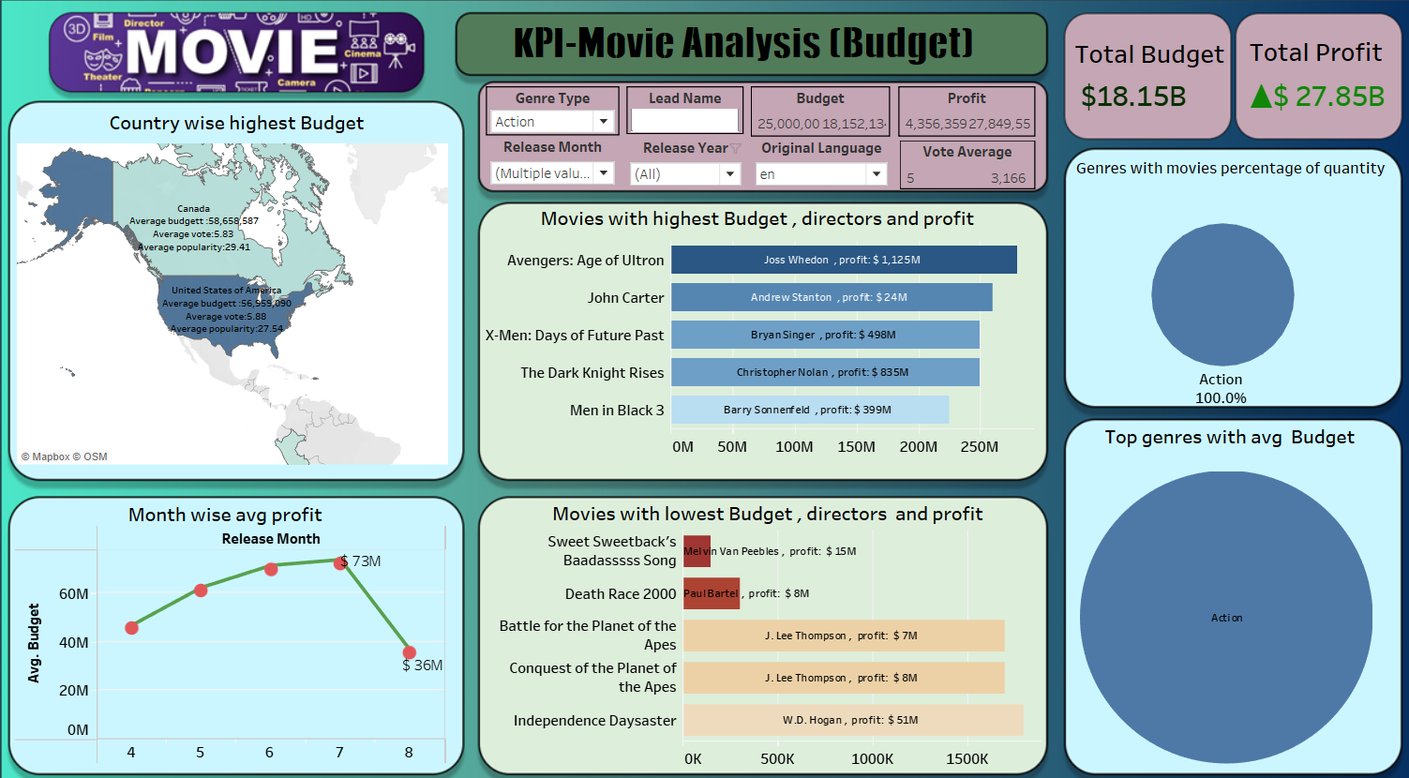
-:Data Exploration:-
Multivariate Analysis
Tableau Dashboard
Top 5 and lowest 5 action type English movies based on budget which released between April to August.

Slide 12
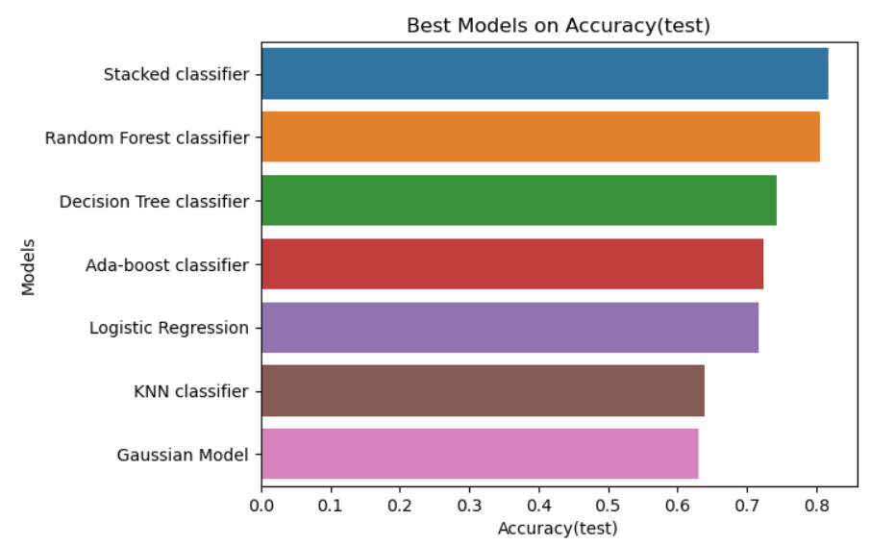
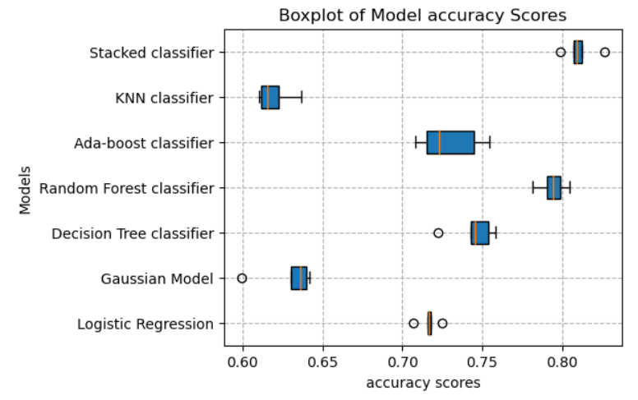
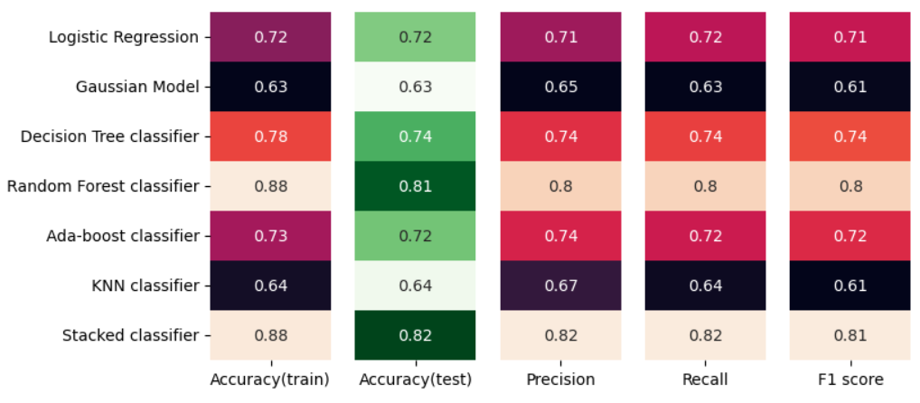





ML Model 1
Prediction of Rating :-
(Classification)
Scores = Good Fit
-:Best Model:-
Stacked Classification

Slide 13
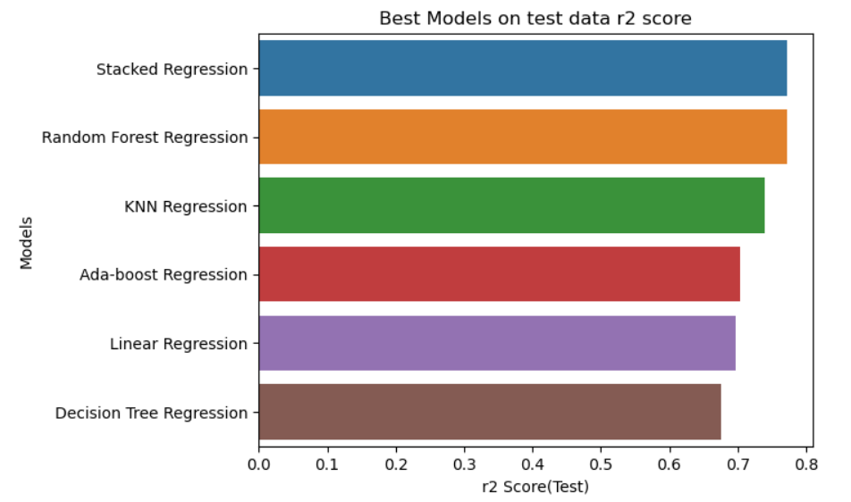
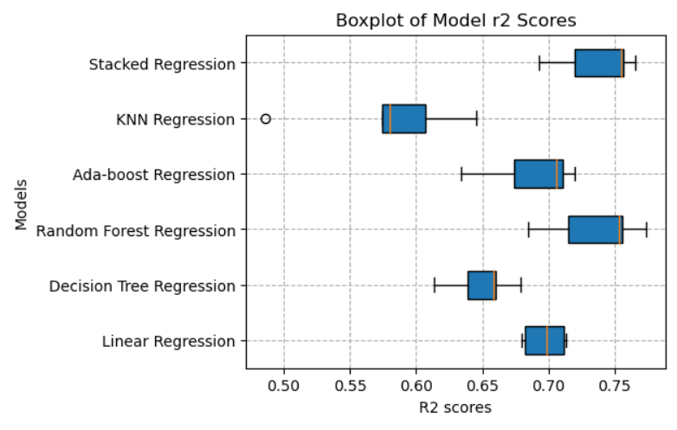
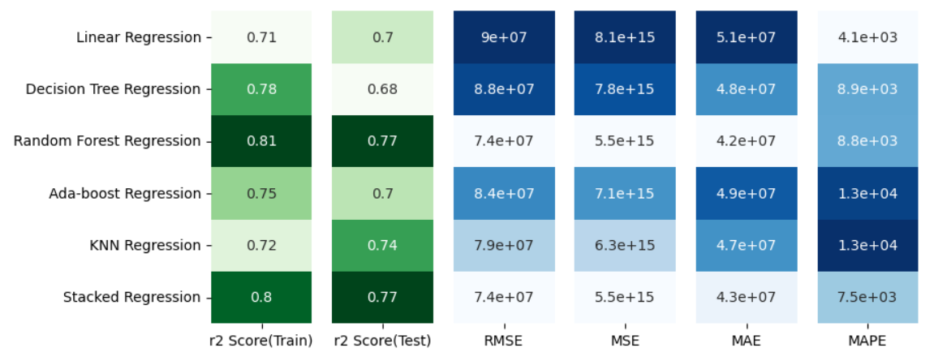




ML Model 2
Prediction of Revenue :-
(Regression)
R2_score = Good Fit
Errors = Bad Fit
-:Best Model:-
Stacked Regression

Slide 14
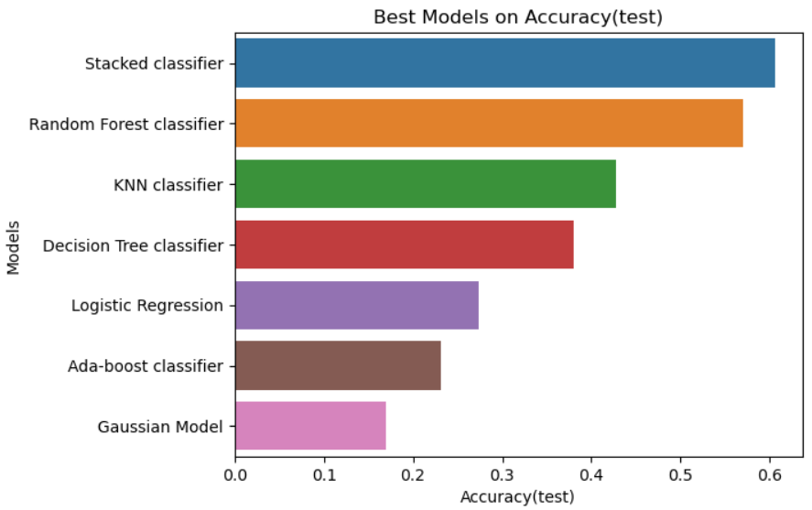
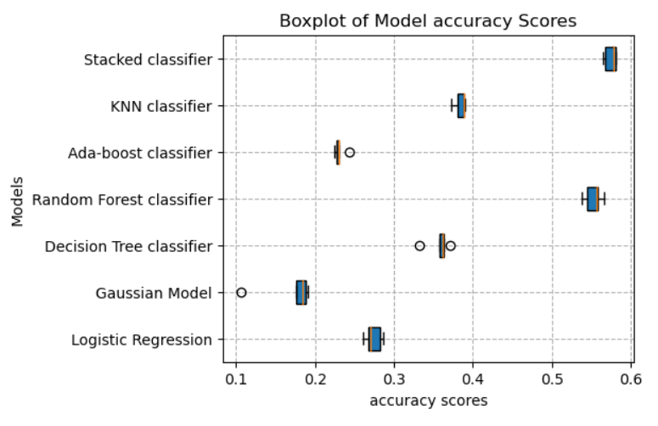
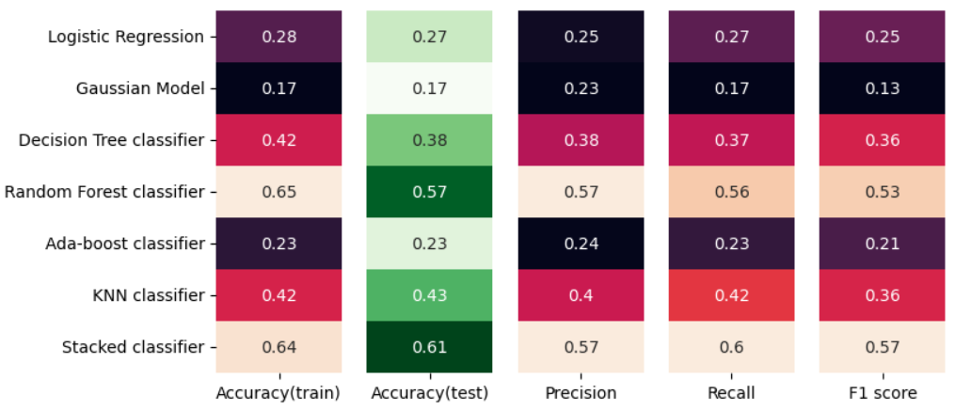
ML Model 3
Prediction of Genre :-
(Classification)
Scores = Good Fit
-:Best Model:-
Stacked Classification

Slide 15
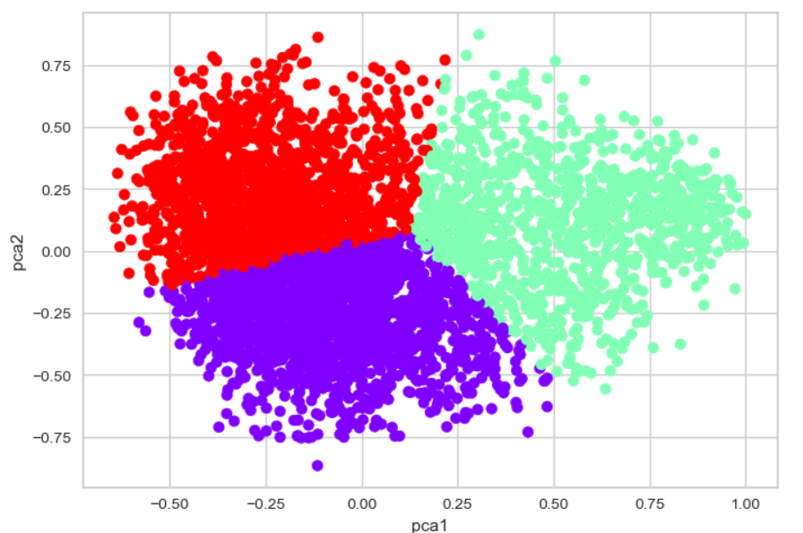
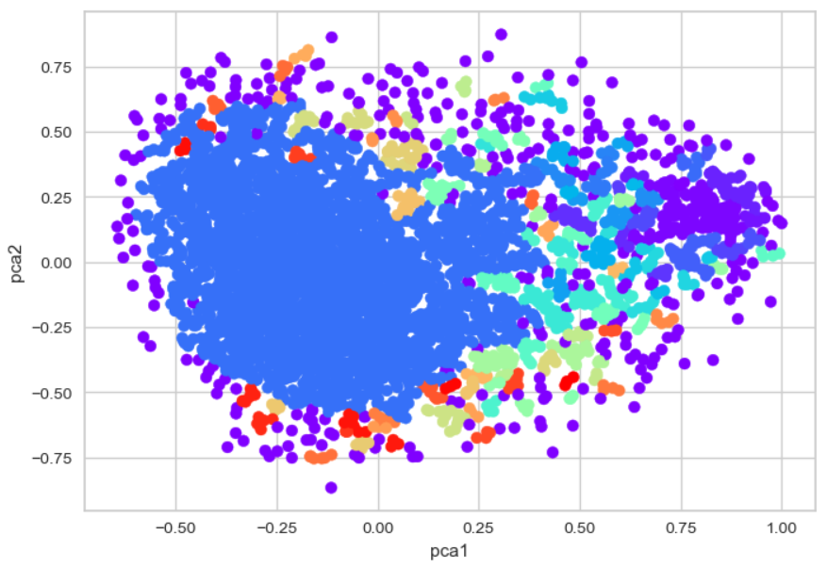
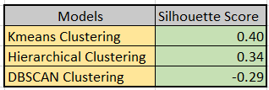
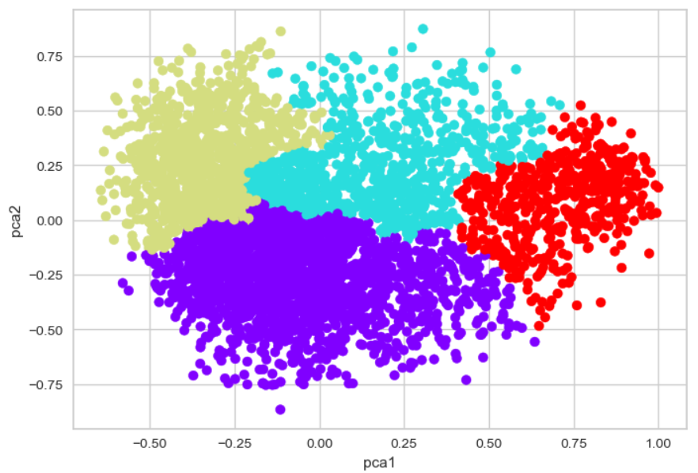
ML Model 4
KMeans
DBSCAN
Scores = Good Fit
-:Best Model:-
KMeans Clustering
Hierarchical

Slide 16
Insights
Genre type is an important factor for profit .Animation and Adventure genres are in top 5 based on average profit, budget and popularity.
2. Old movies contains high ratings.
High run time movies are good rating movies.
4. Popular movies have high profit.
5 If the popularity of the movie is high then it will be a good rating movie.
6. Good rating movies earn profits more that poor rating movies.
7. Almost every genres have a trend to high profit if the movie released in April to
June or in end of the year.
The movies released in January, April and August have chances to get less ratings
and movies that released in December get high ratings.
James Cameron is a very famous director, his movies hold top 2 positions based
on profit.
Important factors that influence movies to be top rated and profit.

Slide 17
Conclusion :
Through our analysis of the TMDB movie dataset, we have identified several significant factors that contribute to higher movie ratings. Our findings indicate that factors such as popular higher budget allocations, specific genres, and strategic release dates have a positive impact on a movie's rating. By leveraging this knowledge, film industry professionals can make informed decisions regarding budget allocation, genre selection, and release timing to maximize the chances of producing highly rated films. This project highlights the importance of data-driven approaches in understanding and predicting audience preferences, ultimately enhancing the overall quality and success of movies.
The Stacked Classification model outperformed other models due to its diverse predictions, error correction, feature combination, ensemble learning, hyperparameter optimization, and ability to capture nonlinear relationships.

Slide 18

?
Any questions

